Slide 1
Cyclistic Bike –Share Analysis By Louisha Nancy J DM21

Slide 2
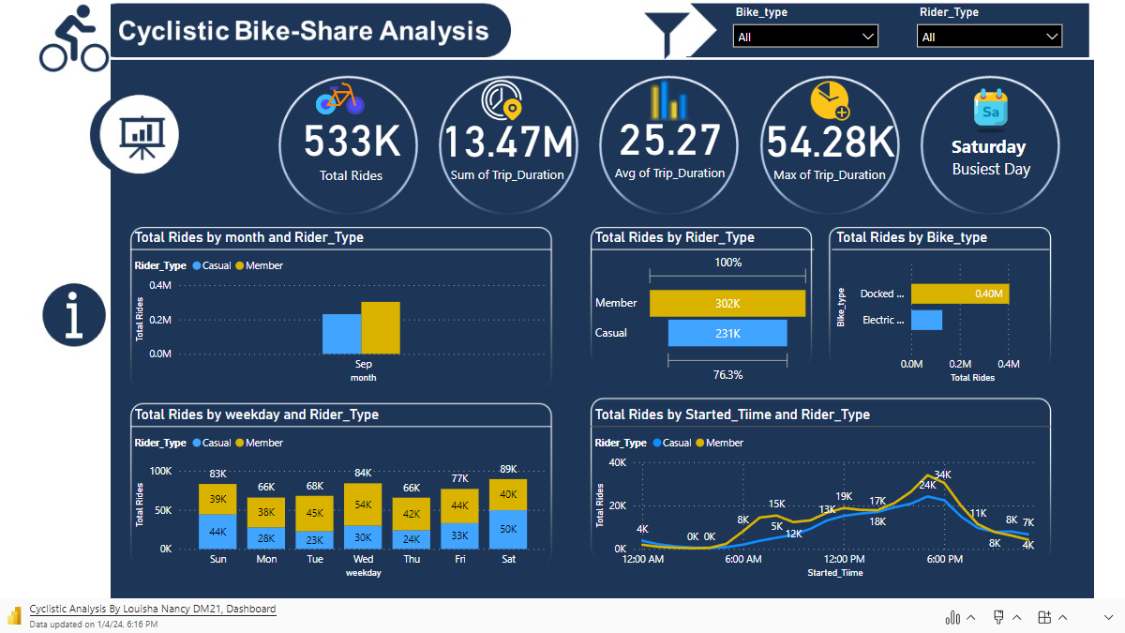

Slide 3

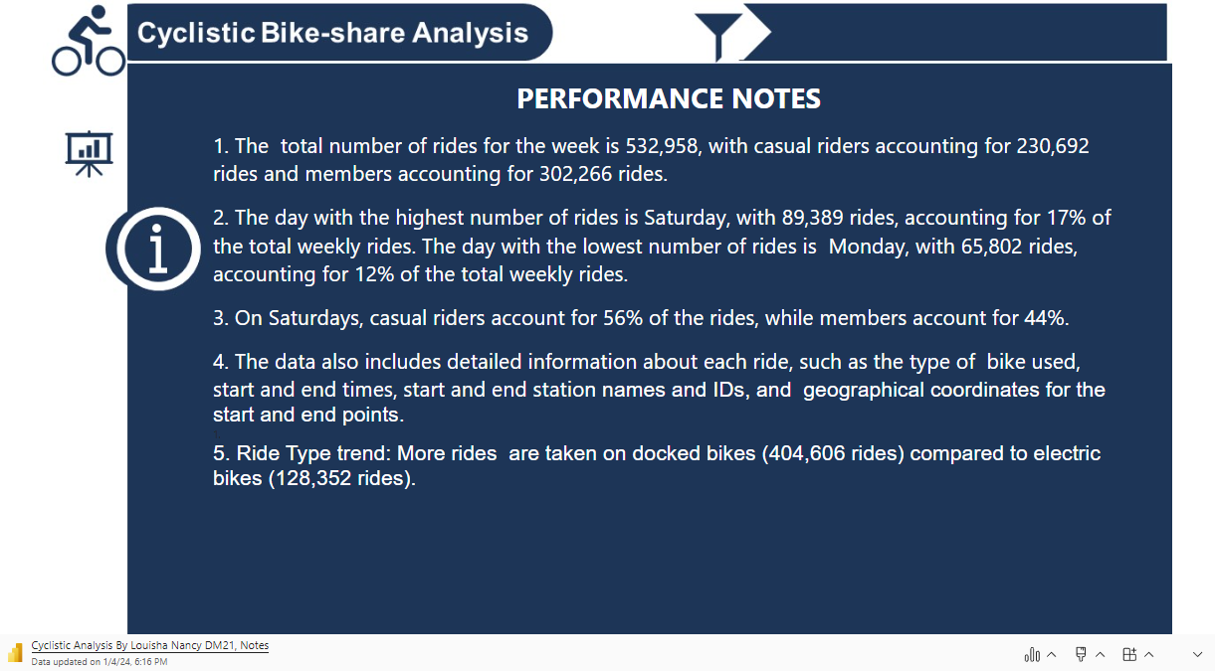

Slide 4
Additional Trend Information
The busiest days for bike rides are as follows:
1. Sunday: 83,185 rides
2. Monday: 65,802 rides
3. Tuesday: 68,013 rides
4. Wednesday: 84,046 rides
5. Thursday: 65,680 rides
6. Friday: 76,843 rides
7. Saturday: 89,389 rides
So, Saturday is the busiest day for bike rides, followed by Sunday and Wednesday.

Slide 5
How do Annual members and Casual riders use Cyclistic bikes differently?
Ride Duration - Casual riders tend to have longer ride durations compared to Annual members. This could suggest that Casual riders use the bikes for leisure or exercise, while Annual members might use them for shorter, more practical trips like commuting.
Time of Day: Casual riders ride more in the evenings, with a peak at 5 pm. This again suggests use for leisure or exercise. Annual members, on the other hand, peak at 7 am and again at 5 pm, suggesting they use the bikes to commute to and from work.
Day of the Week: Casual riders use Cyclistic bikes mostly during weekends, while Annual members use them mostly on working days. This could be due to the different purposes for which they use the bikes - leisure vs. commuting.
Bike Type: Both user types use Classic and Electric bikes, but only Casual riders use docked bike type. This could be due to different preferences or needs - for example, Casual riders might prefer the convenience of docked bikes, while Annual members might prefer the flexibility of dockless bikes.

Slide 6
Conclusion
Based on these conclusions, Cyclistic could consider offering different subscription plans or promotions targeted at the different user types. For example, they could offer discounted rates for longer rides to attract more Casual riders, or they could offer discounted rates for rides during commuting hours to attract more Annual members. They could also consider expanding their docked bike offerings to attract more Casual riders.
Profitability could not be verified because the datasets did not contain data on how the subscriptions are charged, how often the bikes are maintained and the cost of maintenance.
Though Annual members use Cyclistic bikes more, Casual riders ride for longer times. Assuming Casual riders are charged per ride, isn’t it more profitable to have more Casual riders?
These and many other questions could not be answered due to insufficient data, and that, because of data privacy by the company, to protect the user demographics(such as age, sex, location) and cost of different subscriptions.

